Slide 1
Introduction to ML projects
M. Beneitez – miguel.beneitez@manchester.ac.uk
Summer School in Hands-on ML 2026

Slide 2
Project choices
Range of projects within MAE (hopefully useful in your own research!)
Uncertainty quantification
How much can we trust our predictions and where do we need more data?
Reinforcement Learning
Learn to act, control, and optimise sequentially (teaching systems to do things)
Time series and symbolic regression
Forecast dynamics and discover interpretable equations from data
Projects: 3, 4, 6, 9, 10, 13 (although most projects have an UQ extension!)
Projects: 1, 5, 7, 11
Projects: 2, 8, 9, 10, 12, 13, 14, 15
Groups of 2-3 people (ideally) you are also welcome to work individually. If you have your own data or project linked to your research, talk to us!

Slide 3
Project choices
Range of projects within MAE (hopefully useful in your own research!)
Groups of 2-3 people (ideally) you are also welcome to work individually. If you have your own data or project linked to your research, talk to us!
GOAL: Kick-start an ML project entirely on your own, with hands-on experience, show a working pipeline, and give a starting point to develop further
PRESENTATION: Present your problem, approach (how to formulate what you want to do as an ML/Optimisation problem), difficulties and pitfalls. Gift card for best presentation/work!
NOT graded
NOT required to fully work
NOT required to be the best possible model

Slide 4

Project technicalities
Please use the MaSC portal if possible
Basic ML packages should be available (check with TAs if support is needed).
128 cores reserved for applications
4 GPUs
MaSC portal is good for prototyping, but unless required, move production elsewhere, e.g. CSF. Talk to us if you have issues with computing.
Today’s intended learning outcomes:
Plan your ML problem
How to put our data in an ML friendly way
Using git and version control

Slide 5
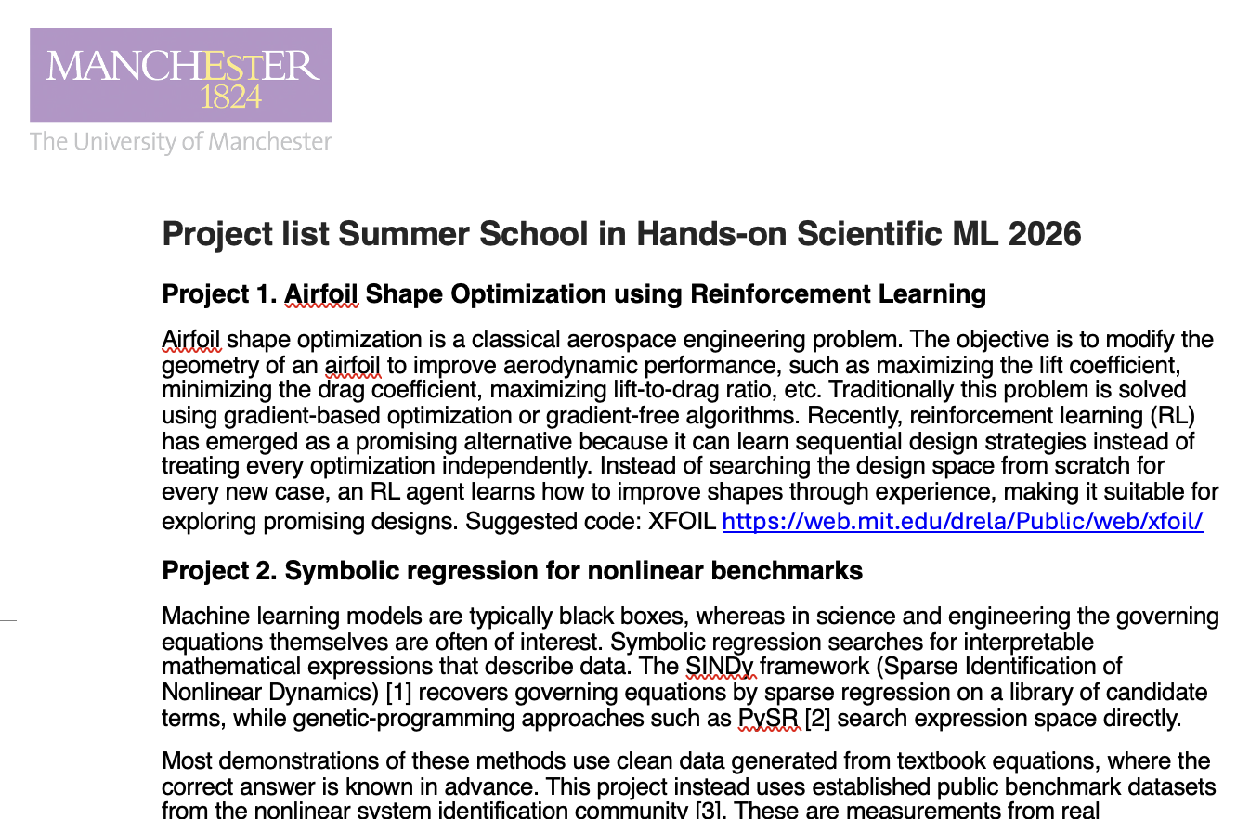
The project list
You might have already selected a project!
Project description: what we are supposed to do?
Suggested approach: some projects already have ideas about how to go on about them
Suggested dataset: which data can we use for the project
Extensions/warm-up problems: before tackling very hard tasks we might want to test the setup on a simpler problem, or maybe we want to reach further than the current topic.
In general: talk to us! This aims to be as interactive as possible, discussing planning ideas, exploring datasets together aims to be part of the course

Slide 6



A note about genAI
Realistically, a lot of the projects suggested can be done partially/entirely using AI.
The goal of the course is to be able to build and justify your ML projects
We do not check/penalise the use of AI, but please, disclose it if you use it.
Reflect about the best use of your time!

Slide 7

A sample of projects
Sample of each one of the 3 topics
Example: 1. Airfoil Shape Optimisation using RL
Problem:
Optimise an airfoil geometry to improve aerodynamic performance
How to do this?
Use NeuralFoil to quickly test the aerodynamic performance of an airfoil (physics part)
Define the degrees of freedom for the optimization (posing the problem in an ML-friendly way)
Set-up training + evaluation pipeline (ML pipeline)

Slide 8
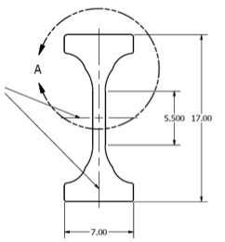
A sample of projects
Sample of each one of the 3 topics
Example: 8. Real-time defect detection in additive manufacturing
Problem:
Detect manufacturing defects in real time from multivariate in-situ sensors enabling early build termination and closed-loop control.
How to do this?
Plot the healthy/unhealthy parts of the dataset, align multi-rate sensor with data (physics part)
Frame the problem as an anomaly detection (posing the problem in an ML-friendly way)
Set-up training: split by build not time window, set up baseline with simple regression, move to CNN (ML pipeline)

Slide 9
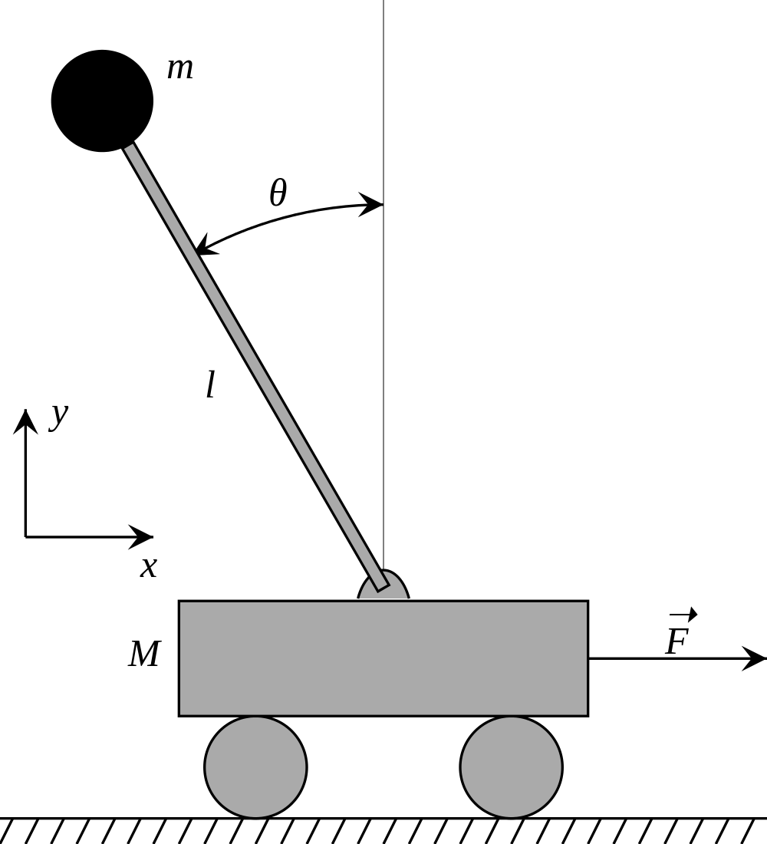
A sample of projects
Sample of each one of the 3 topics
Example: 6. Uncertainty aware PINNs (Physics-informed neural networks)
Problem:
We know the underlying equation, but we don’t know the parameters of the problem.
How to do this?
Define what is known, and what we want the network to infer (physics part)
If experimental data, make sure it is clean if synthetic control the difficulty of the problem(posing the problem in an ML-friendly way)
Set-up training and the UQ, how much can we trust our estimations? (ML pipeline)

Slide 10
The scope of the project
How far should I stretch in the project?
Project selection
Choose something that you are interested in
Projects are suggestions, but we want you to shape them!
Adapt it to your goals
Set up the project based on your experience
If you are very experiences, dare to go beyond the suggestions! If you are a newbie in ML/computing, doing a warm-up problem is an impressive achievement!
Compute budget
Be realistic about resources
It is more valuable to have a full pipeline design rather than a lot of data and no time to use it
Resources: We have 124 cores in MaSC and 4 GPUs. This can be used for prototyping, but if you are going big, consider other resources, e.g. CSF
Example: I find the idea of project 1 interesting but I want to use a different geometry
Talk to TAs/lecturers to scope the project together
Once you’ve chosen a project/direction, the rest of the session should be applicable independent of the topic. Focus on good practices

Slide 11




The problem + ML pipeline
Typical ML pipeline: data, model, loss, optimisation
DATA
MODEL
LOSS
OPTIMISATION
iterate: refine model / retrain with new data
We need enough data, a good enough model, a loss (objective) to mimise/maximise and an optimiser to find the next step.

Slide 12




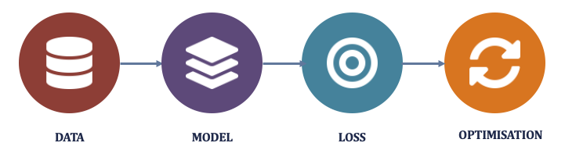
The problem + ML pipeline
We need to build a problem around this
Frame
Explore
Prepare
Baseline
ML pipeline
Evaluate
The ML pipeline is a part of a bigger setup

Slide 13
Framing and exploring
Frame and explore before modelling
Applied to: RL for airfoil design
Asking the “right” questions
Input: Drag and lift coefficients for a design
Output: Design which achieves the max lift with min drag.
Task: Reinforcement learning, requires an action (geometry modification)
Success: best performing airfoil, or airfoils based on the geometry
We need an input and output/target
What type of problem do we have at hand? Regression, classification, control? Can we reframe the problem? Does it help?
What does “good enough” mean?

Slide 14
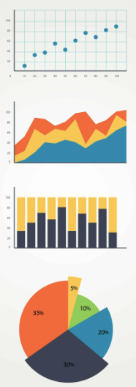
Framing and exploring
Frame and explore before modelling
Common questions
Look at raw data/few samples/run a few cases/make some animations. What is ”normal” or expected. Recognise if something is going wrong downstream
Check distributions and ranges (if required), e.g. is my data Gaussian? If not, maybe I can’t expect to represent it well with some methods.
Experimental/real data might be noise and contain outliers. Plan how to treat these.
Check if the relevant data is evenly distributed. Is my training data statistically similar to the test/evaluation case?

Slide 15
Splitting the data
Need to be careful
Time windows: ensure that the same data does not end in different windows or that data is discontinuous. E.g. if we are predicting time series across trajectories, make sure pairs are confined within the trajectory.
Data is repesentative: if we are looking for e.g. defects, make sure that there are enough in each time window.
Test your setup: taking a very small subset of data can be useful to test end-to-end process. Very good control what is going in and out
Training set
Test
The model learns in the training set and we hold out a test set to give an honest estimation of the performance. Typically training set ~80% of data

Slide 16
Preprocessing
Machine learning is essentially Statistics and we need to prepare our data: preprocessing
Normalise and scale
Often required to put inputs on comparable scales, otherwise one feature might dominate. E.g. the different velocity components in a flow field
Encode carefully
If you are encoding (finding representations) do this carefully: take patches of relevant size or use dynamically relevant times. E.g. if your data is asymmetric, ensure this is considered in design
Feature engineering
Balance the addition of manual features. See example Jupyter notebooks. Adding more information about the system helps small datasets, bigger models can learn on their own

Slide 17
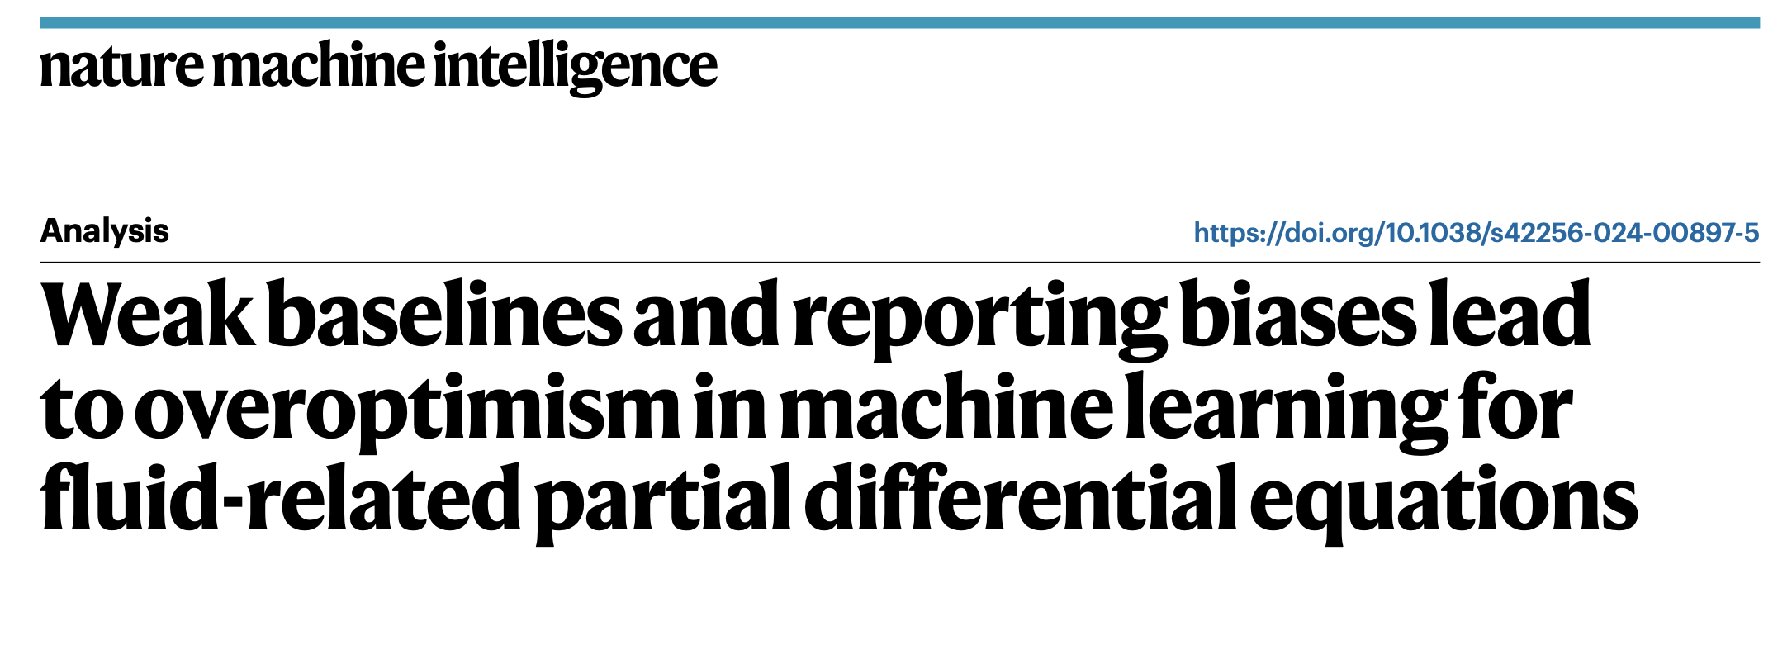
Setting strong baselines
Ensure a fair comparison of the methods. Important when comparing a model’s output and cost.
Mean/majority prediction
For regression tasks, predicting the mean is the first task to beat. For classification tasks, predicting the majority is the one to beat
Linear/logistic regression
Simplest interpretable model to beat. Linear regression for regression tasks, logistic regression for classification tasks
Naive
In time series and prediction tasks: Identity
Future is identical to present state (identity when predicting outputs)

Slide 18
The metrics of success
What we optimise for defines how good the models are
Regression
MSE for smooth solutions, L1 norms for sparsity, weight different elements differently.
Uncertainty
Calibration and coverage, i.e. does 90% interval actually contain the truth 90% of the time?
Control
We optimise cumulative rewards, but the present might be more important than the past, there is some tuning.
Compare against baseline and against other

Slide 19
Debugging and sanity check
Use a tiny subset
Let the model overfit when you already know the answer. This should point out structural issues with the methodology
Watch the loss
Check if your loss is decreasing, stagnating or spiking, it usually tries to tell us something.
Check shapes and stats
Make sure the data has the shape and size you want. Check the statistics are what you expect.

Slide 20
Iterate several times
Don’t run just once! (if you can afford it). These are statistical methods, the best model might be one single run away, but also important to know what the average model does.
Be fair in comparing models
A model that has trained for longer might perform better, report training/testing/datasets when reporting models to avoid being biased
Model cherry-picking
It is ok to use the best model across runs for production but keep a log of the spread and report it. This is valuable for the wider community and important in reliable AI.
Test set
Don’t use it while setting your hyperparameters, otherwise it is just validation data
Know when to stop! At some points there might be diminishing returns to your model

Slide 21
Version control and reproducibility
We are making progress in the code but it is important to keep track of what we are doing. Important if we share code, add new features, or work across platforms
Why we want version control?
Keep your working space tidy! No project_final_final_realfinal_final_v3.py
You can work in parallel and easily combine code and documentation
A safety net: if something breaks, you can always go back to a previous version
We suggest using git and github for this. You can create a public (or private project) to collaborate with others.

Slide 22
Version control and reproducibility
Some important words
A repository: the project whole history, stored on github and shared with the group members.
A commit: a saved snapshots of your changes with a brief description of what they are.
A branch: an independent line of work, typically implementing a feature, that will be merged with the main once done.
Remote: the shared copy on github that everyone pulls and pushes to.

Slide 23
What to do this afternoon?
Make a rough plan for the project, discuss it with the TAs to see if it is reasonable
Set up a github repository, make sure you can do a commit, pull, push, create a branch and pull request. Share it with others in the group
Prepare a dataloader with your data, and get started on the whole pipeline. If you are already at the ML stage, feel free to discuss this with the TAs
If you have time, prepare the slides about the physical background for the presentation

Slide 24
Thank you for your attention!
Happy to take any questions

